Slide 1

Data Driven Education
Discussion Forum Subteam
Presentation 3 - 11/30/2022
Notes:
Pratik

Slide 2
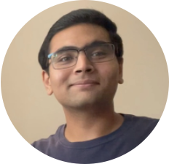
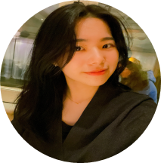
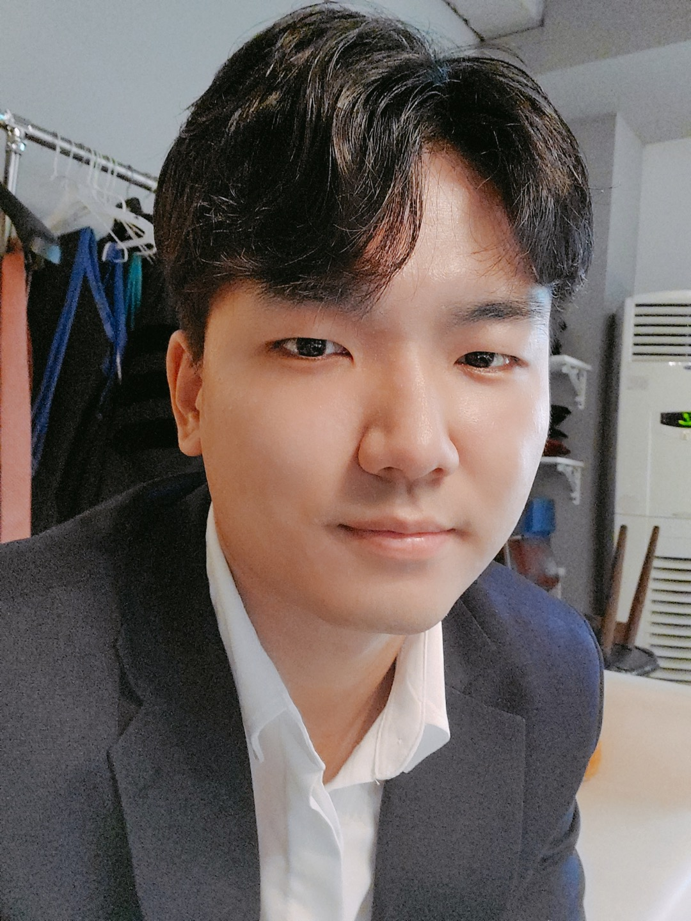
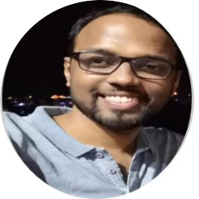
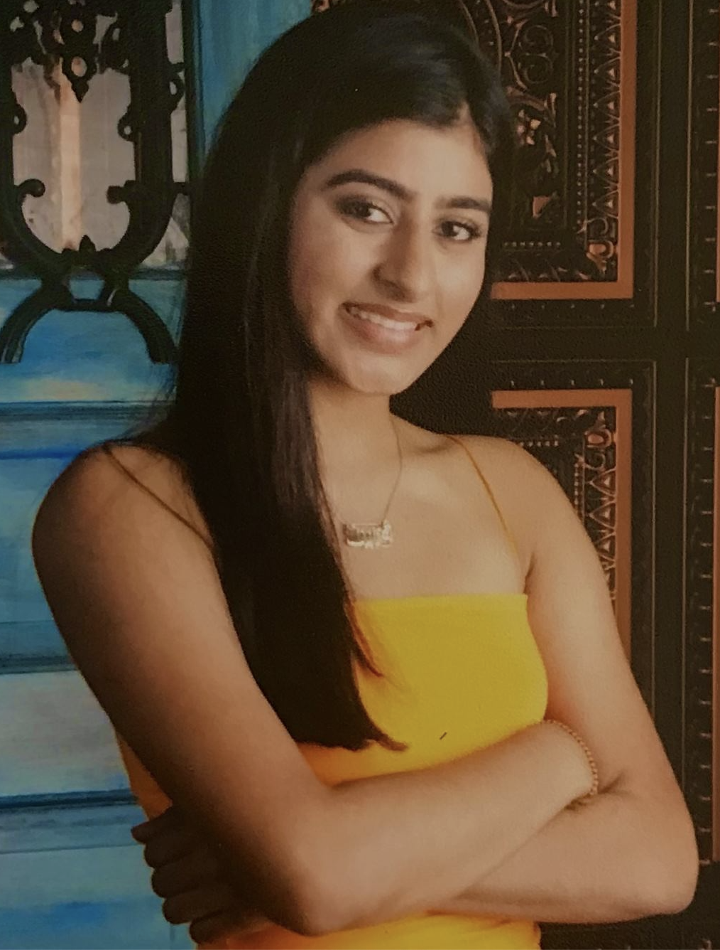
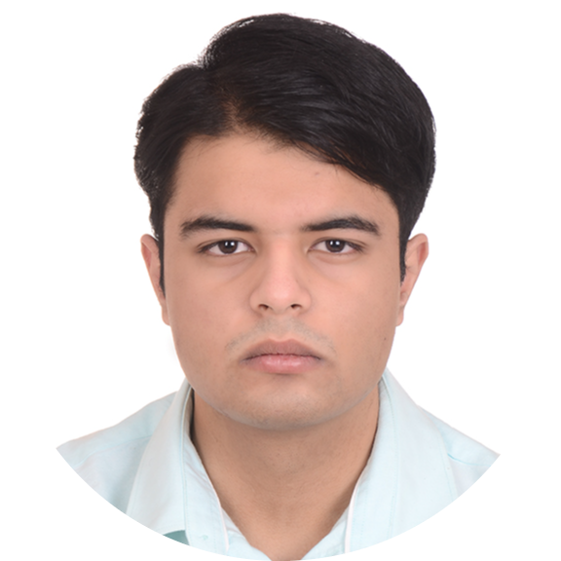
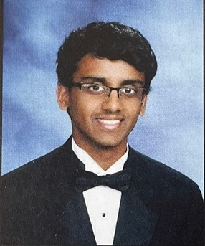
Team Members
Malav Patel
Data Scientist
Hyun Soo Kim
Data Scientist
Jisan Park
Data Scientist
Pratik Agarwal
Project Manager
Ankit Mishra
Front-end
Web Developer
Gautam Sugasi
Back-end
Developer
Ritika Gehani
Front-end
Web Developer
Notes:
All

Slide 3
Outcomes from Fall 2022
Category | Accomplished | Next Goals
Web Dev | Dashboard ready, working on artificially generated data | Connect with data science backend and test integration
UX Research | This bit will start after dashboard is ready | Interview instructors to get feedback on our dashboard
Data Science | Aspect-based sentiment analysis model Documentation for future team | Piazza Q/A, integrating cognitive presence modeling with other models
Learnings and Challenges as a Project Manager:
Could have been more proactively communicating with instructors from the start
Having clear weekly deliverables helped the team stay more focused
Team members having more context of project can help bring their team together and enable better coordination
Monthly targets and sprints helped, but should have kept more buffer
Notes:
Pratik:
This semester we focused on deploying our dashboard web-app, which should help instructors get insights on class participation, forum activity, instructor involvement etc. More specifically we’re interested in showcasing the class sentiment around different aspects of the course, like the content, grading, instructor responsiveness, etc. We’re using Aspect Based sentiment analysis for this, which the data science team worked on this semester. The outputs from the model are then passed on to the dashboard for the instructor to get a visual representation of the same. More details will be shared by the respective teams. We are 1 step away from this integration that is connecting the data science backend to the dashboard front-end, after which we can conduct interviews with instructors to get feedback on the same for the next iteration. As a project manager, I got to learn a few things, mainly the importance of having pro-active communication between teams and also with instructors which could have been a little better from my end. Having clear monthly targets and then specific weekly deliverables in line helped keep the team focused. However, more buffer time could have been accounted for given other commitments of team members and unforeseen circumstances. Passing on to the Data Science team.

Slide 4
Data Science
Notes:
Malav

Slide 5
Research Goal
Based on the community of inquiry framework, what are some key factors in discussion forum activities influencing student engagement and performance in an asynchronous online classroom?
How can we design a web app that can provide actionable insights to the instructor in order to increase engagement and performance?
Notes:
Malav
Our goal was to analyze student interaction with their peers and understand their engagement and performance in a classroom. One way we achieved this is by creating a dashboard that could provide visuals about the sentiments and topic analysis from their interactions within the online learning community. Our team’s main goal for this semester was to deploy a functioning dashboard that could provide more valuable feedbacks to the professors and can help them structure their courses in the future.

Slide 6
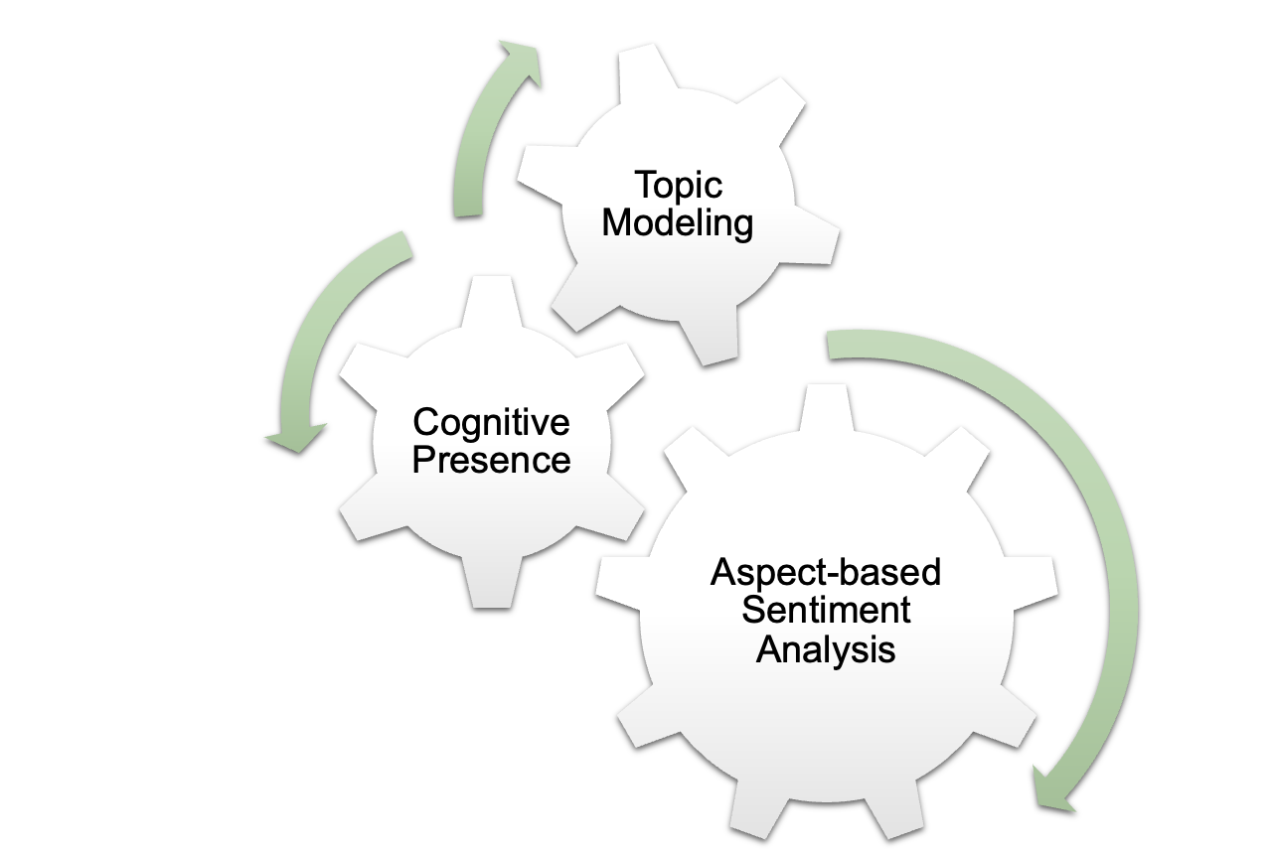



Data Science
Notes:
Jisan

Slide 7
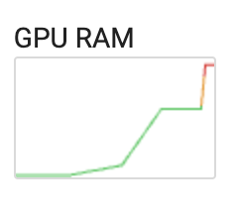
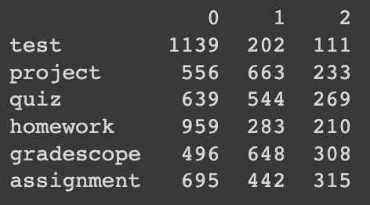
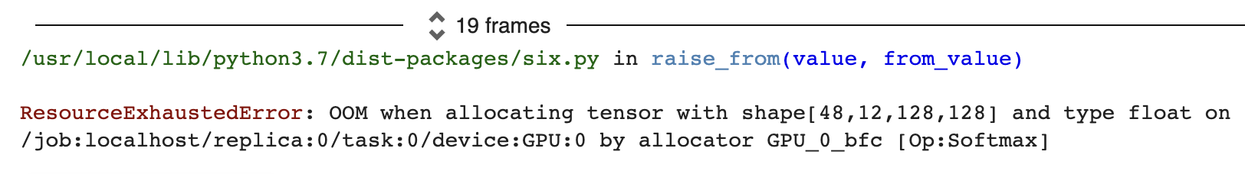
Challenges - ABSA
We have to buy colab-pro version to train the model.
  Too many tokens -> took very long time, GPU out of memory
  Pre-processing helped, but had to be careful
Still need to pick topics. For now we have chosen the common topics, we can choose topics from Topic Modeling.
Accurate problem - pre-processing still needed, too many neutral sentiment (0 - neutral)
Notes:
Jisan
Our ultimate goal for this semester is to improve all topic modeling, cognitive presence, and aspect-based sentiment analysis and to actually build a pipeline from data science model to our web page dashboard. We are planning to generate our result as a .csv file to deliver our output to web-dev team.

Slide 8
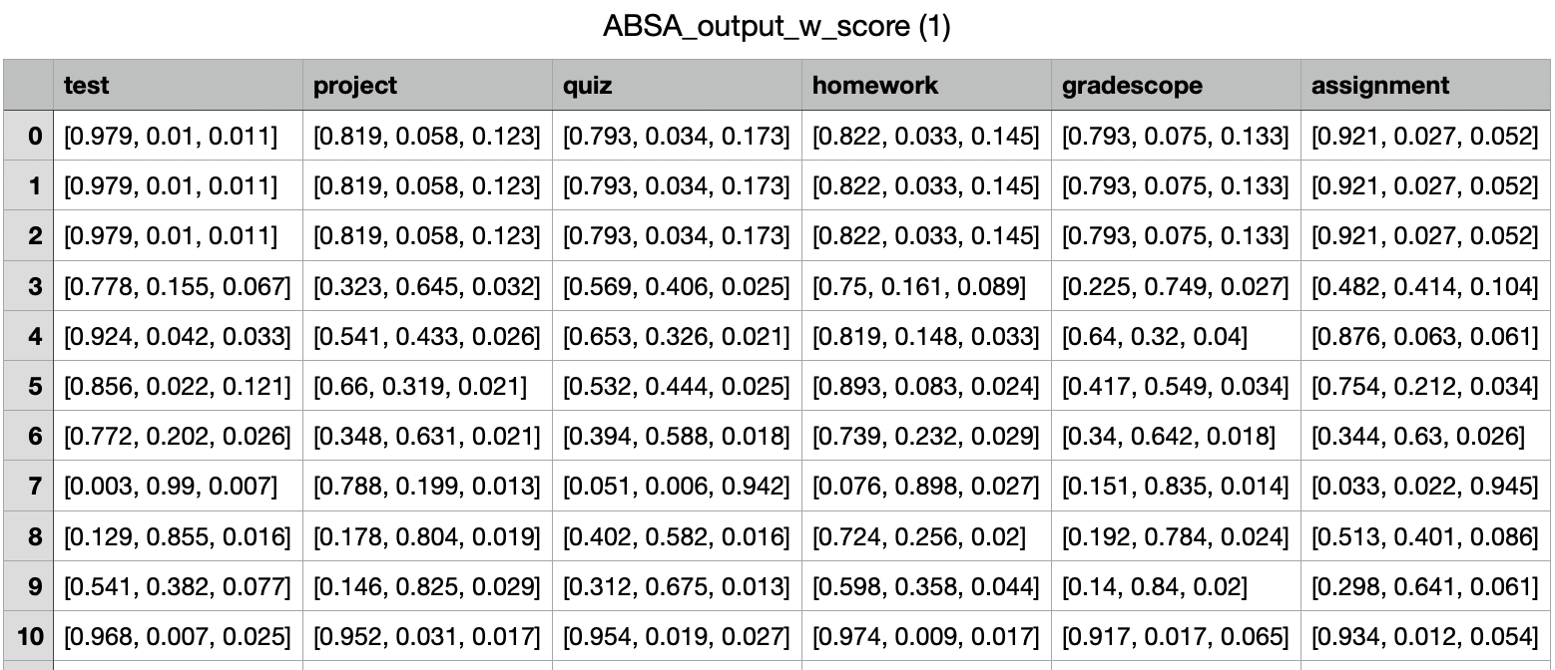
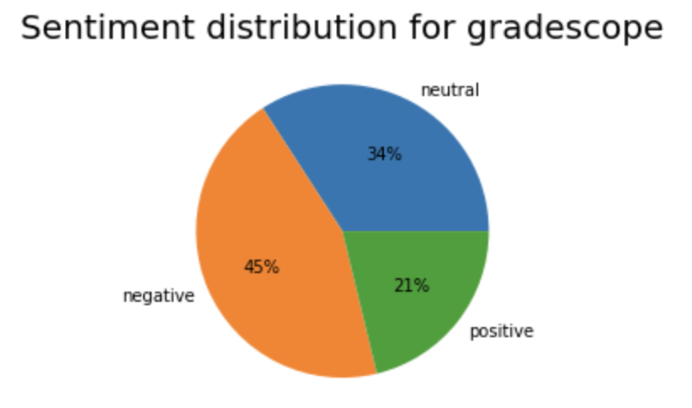
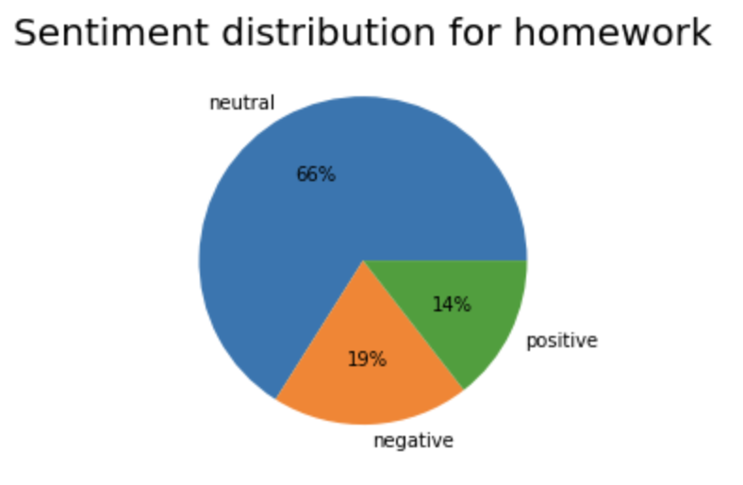
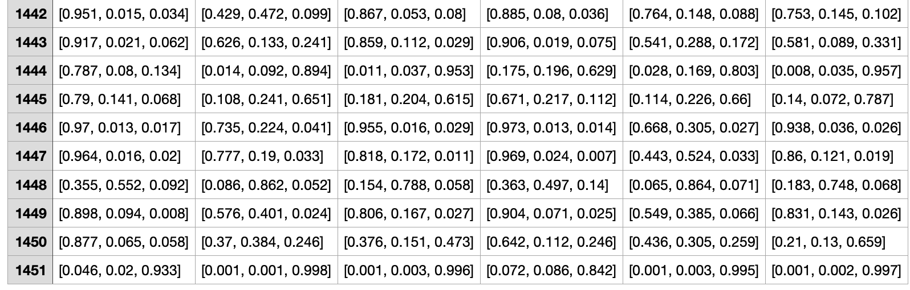
Outcome- ABSA
Graph for each Aspects
CSV file
Notes:
Jisan

Slide 9
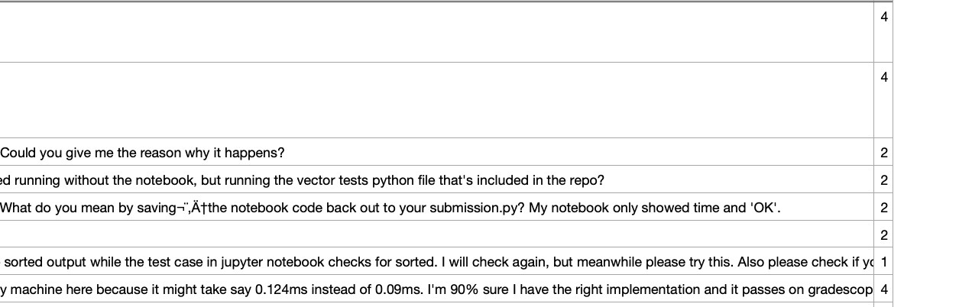
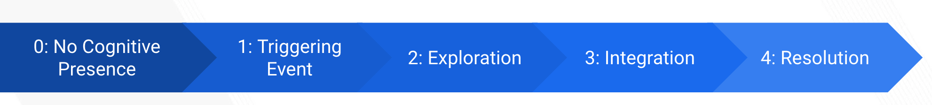
Outcome- Cognitive Presence Modeling
Challenges
No new Piazza data available to test our saved models
  We’re splitting the existing data into 80:20.
Assigning the scores was hard
Since the model was developed by a different team and it wasn’t documented, we had to understand the model from scratch and implement a way to run new data through the model.
Notes:
Malav- This is the result of the cognitive presence modeling that we provided to the web-dev team in a csv format. As you can see in the rightmost column a value is assigned to each row depicting that a comment has no cognitive presence being a 0 to the resolution stage being a 4. The biggest challenge we faced was lack of documentation about how the model is designed. It took us some time to understand the model and how to assign scores based on the tensorflow library. Therefore, for this semester we have focussed a lot on documenting our work for future teams to build upon that.

Slide 10
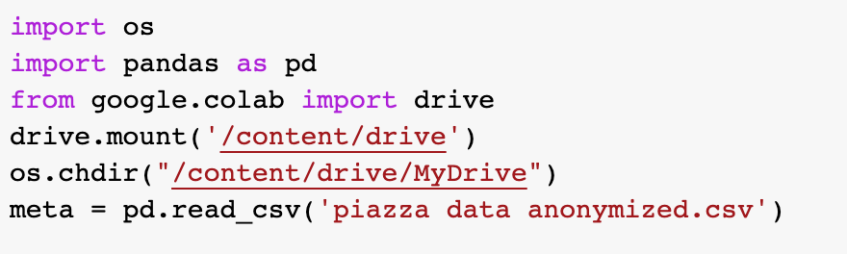
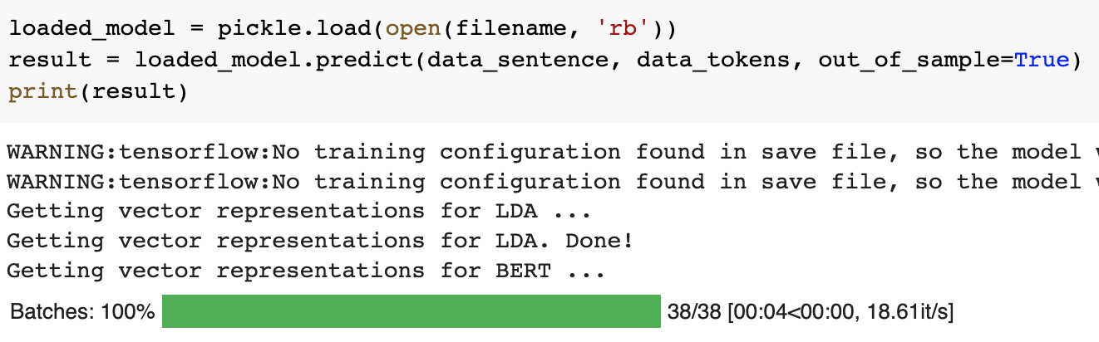
Python Script
Challenges
Cannot access the API directly
No new Piazza data available to test our saved models
  We’re splitting the existing data into 80:20.
Were facing issues running SQL script and connect the database
Notes:
Malav
We have finished our work on the Python script. We were able to run the test data on the saved models (Cogitive Presence and ABSA Modelling). For now, the script is reading data from the csv file and generating output data for individual models and we are manually providing them to the web-dev team. In the future, once we deploy it and public API keys are available, we will be fetching the data using the Piazza API and directly connect it with the front-end code base, laying a foundation for the back-end.

Slide 11
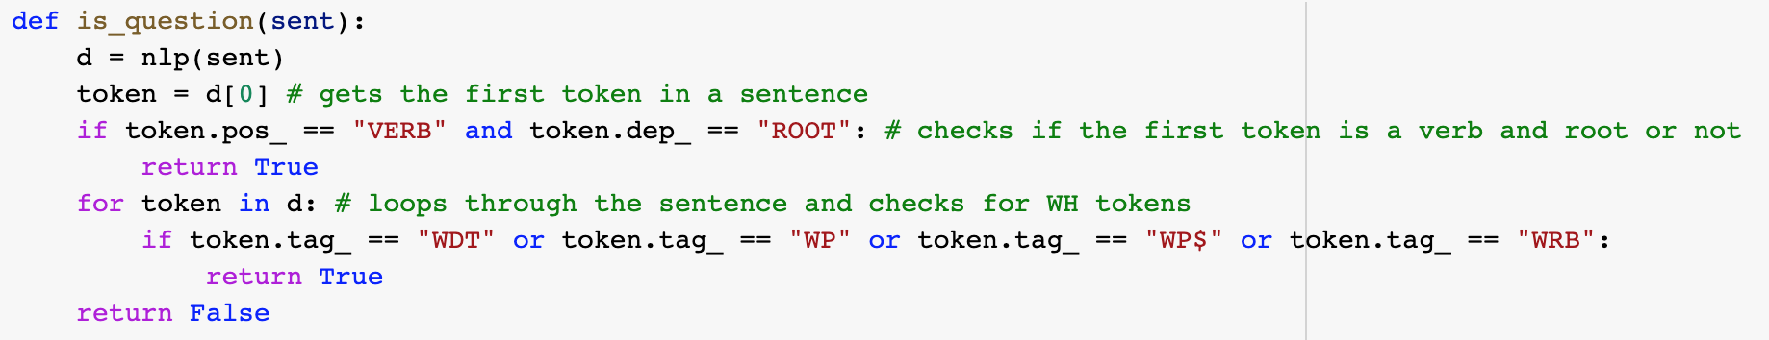
Outcomes- Piazza Feature
Used token matching to separate the list.
Split the answers_data in 80:20 (train:test) and ran topic modeling.
Started with generating distribution using topic modeling
Future Steps:
Continue with topic distribution on the 10/20/30% answers dataset
Continue with the python script to automate the process
Notes:
Malav
We we able to start our work on the Piazza feature that we this semester. For now, we used token matching to separate the questions and answers, but it’s not quite accurate. Also, we have started working on the python script and the future step in our process would be to run the 20% data on the saved model, and get a list of topics. Then we’ll be matching these topics with our database with the similar topics and would list out the results. We hope that the fully developed feature could be added to Piazza and is helpful in answering a lot of repetitive questions about both the logistics and content that could have been answered in the previous semesters.

Slide 12
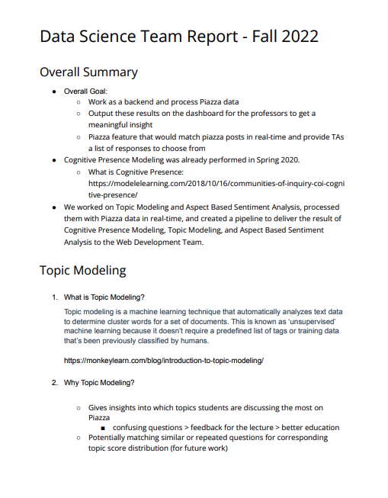
Outcomes- Data Science Documentation
Wrote a 5-paged Data-Science Team Report for Fall2022
Concept documentation
Modules used
Code explanation
Example inputs/outputs
Challenges/What to do in the future
Notes:
Harriet
Our last outcome is a 5-paged Team Report for future members. As there were a lot of codes we wrote this semester, we thought a guideline should be helpful for future members to go through what we have done.

Slide 13
Challenges and Learnings
Topic Modeling
    Unsupervised Machine Learning -> some topics are irrelevant to the lecture
    Accuracy problem (need more data)
  Aspect Based Sentiment Analysis
  Pipeline of getting Piazza data as a .csv file
    Could only test with test Piazza page that we have credentials with
What we learned
  Not only solving technical issues, thinking at the perspective of real users makes a better product
Notes:
Harriet
There were a few challenges. For topic modeling, since it was an unsupervised machine learning, some topics were irrelevant to the lecture. Also, we were lack of data so the accuracy was quite low. I will pass the challenges in ABSA because Jisan has already went through it. And for the pipeline, when we were getting Piazza data, we could only test it with the test page that we have credentials with. So in the future, we expect to test it with more data to actually see some meaningful data going through the pipeline.
From all these challenges and works, we learned that not only solving technical issues, thinking at the perspective of real users makes a better product.

Slide 14
Future Steps
Piazza Feature Analysis
Topic Modeling using LDA+Bert is already implemented for the future team.
Training and Testing on a different split.
Implement a fully functional feature that could be added to Piazza for large classes
Improve Topic Modeling & ABSA models
Improve accuracy for Topic Modeling: try supervised Machine Learning
Improve accuracy for ABSA: reduce data pre-processing or try different modules
Test the models with other datasets from other courses
Explore a new research area in education space
Notes:
Harriet
Our future steps would be improving the models. To improve accuracy, we can try supervised Machine Learning for topic modeling and reduce data pre-processing or try different modules in ABSA. We also can test the models with other datasets from other courses.

Slide 15
Reflections
What we did well?
  Built a solid pipeline from Piazza -> Machine Learning Model -> Dashboard
  Solid documentation for future members
  Every team member actively participated in weekly sub-sub team meetings and helped each other
What could have been done differently/better?
  We could have done code review together after building a model to get more accurate/faster results
  A well-defined timeline could have been helpful in achieving all the goals
Notes:
Harriet
To reflect, we built a solid pipeline from Piazza to, Machine Learning Model, and to the Dashboard, and built a solid documentation for future members. Also, every team member actively participated in weekly sub-sub team meetings and helped each other.
And I think we could have done code review together after building a model to get more accurate/faster results.

Slide 16
Web Development

Slide 17
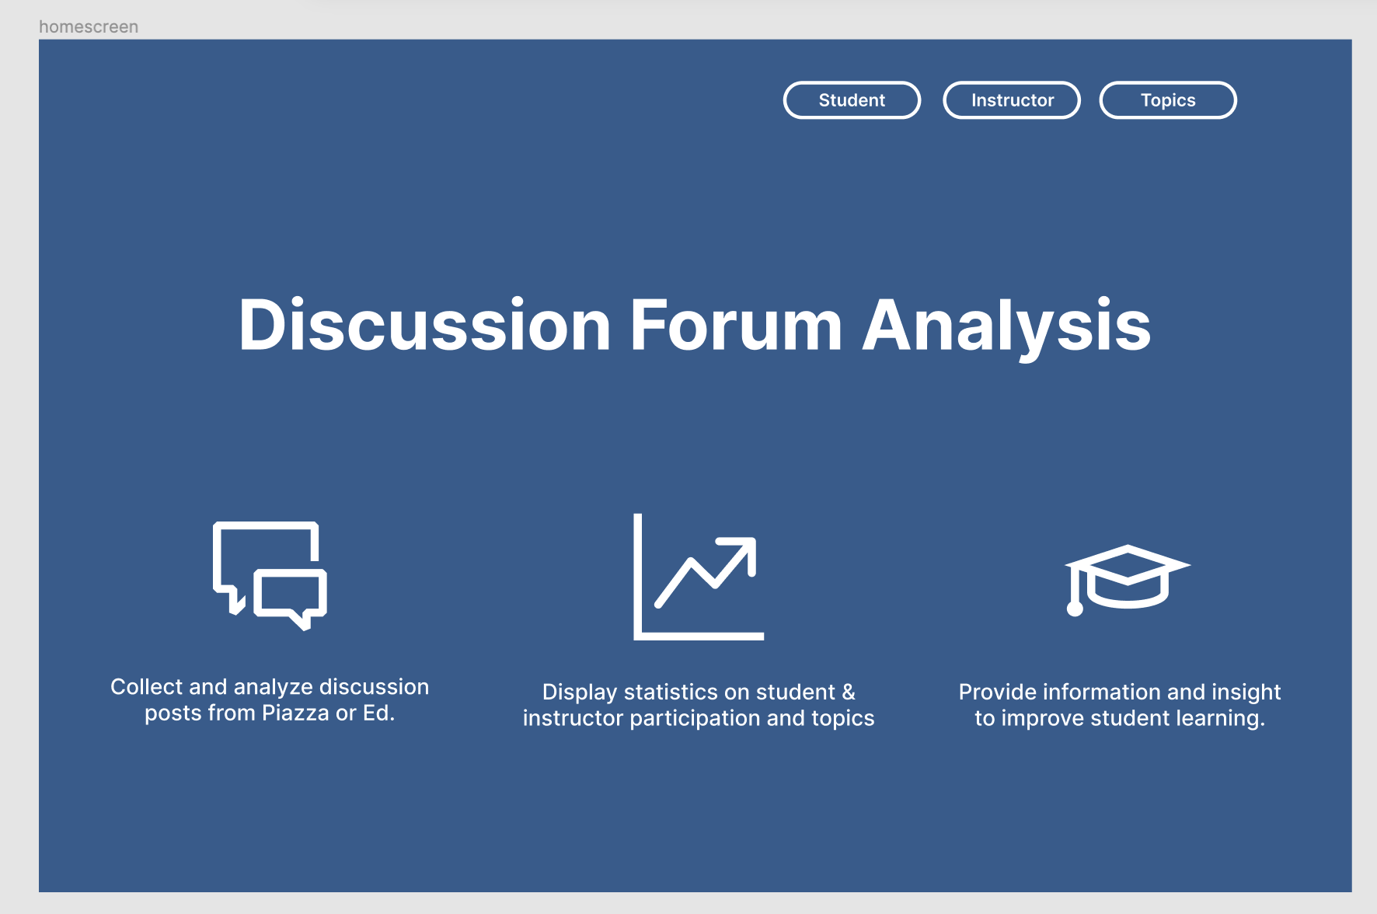


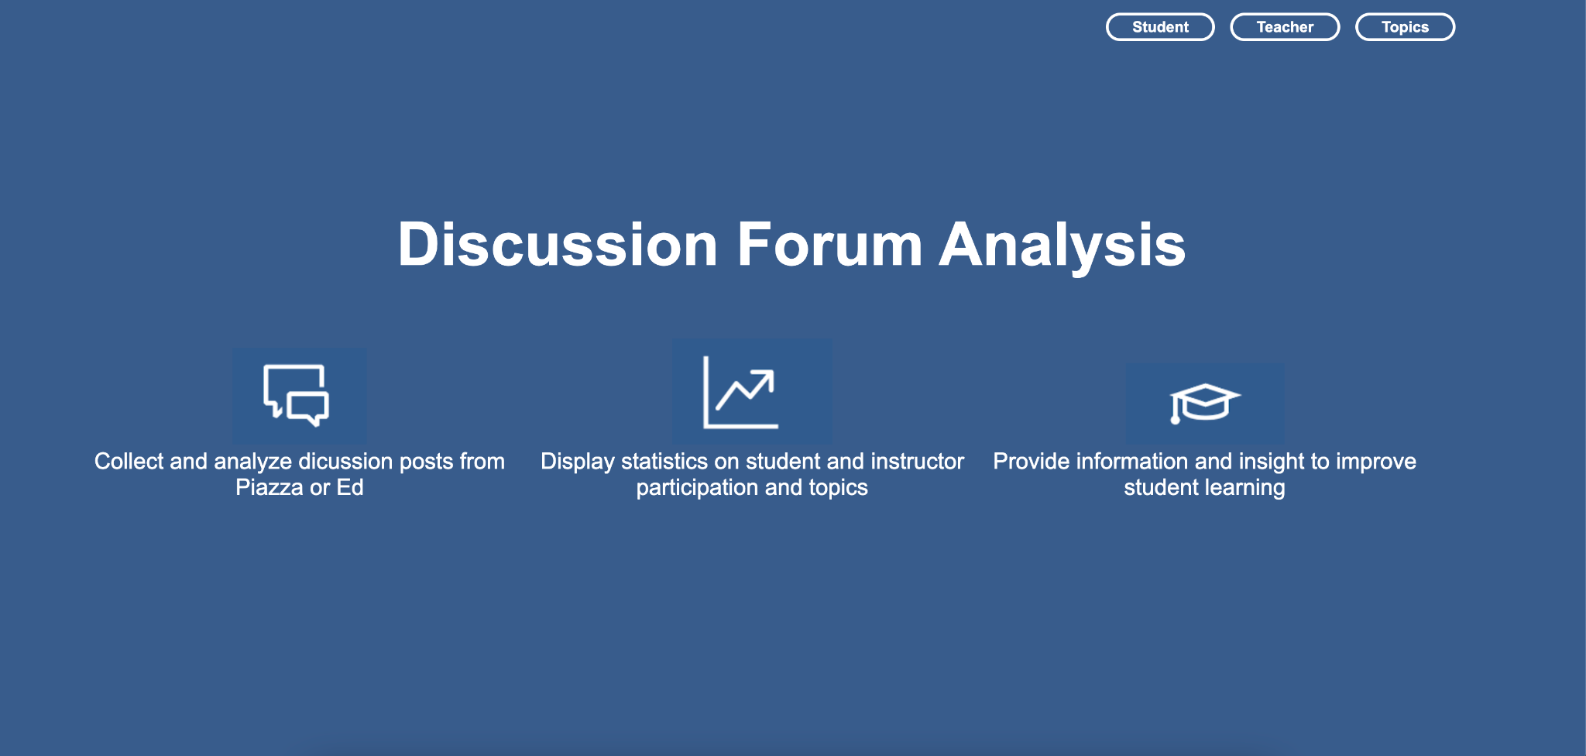


Outcomes - Web Application
Notes:
Gautam

Slide 18
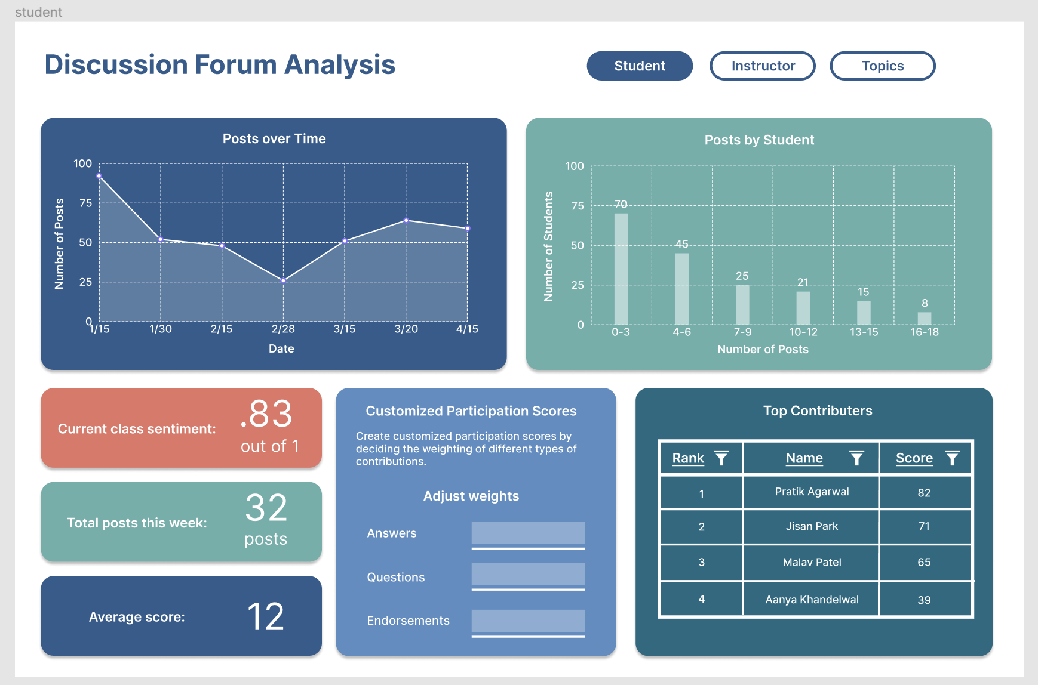
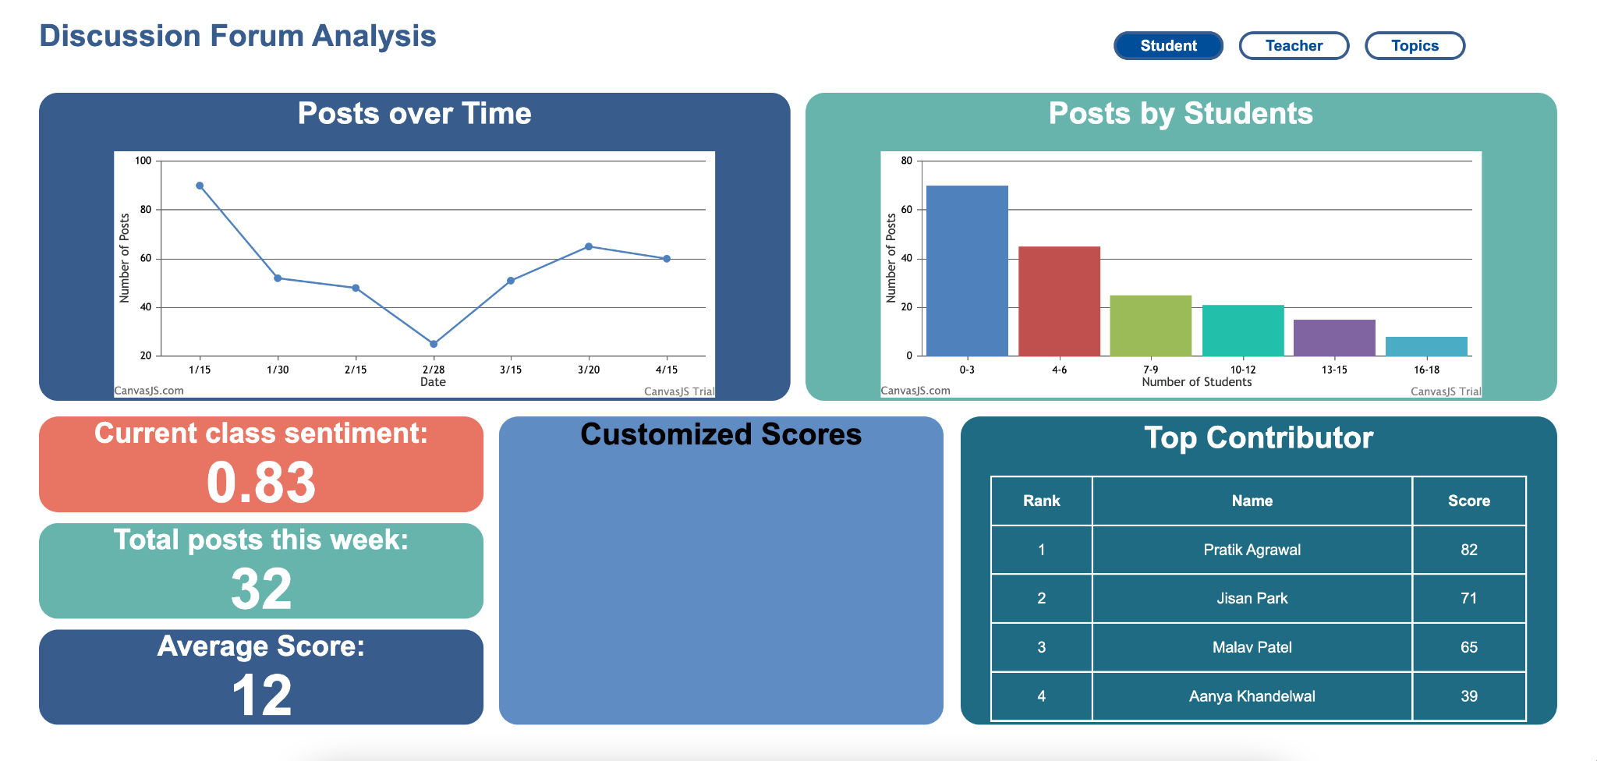
Outcomes - Web Application
Notes:
Gautam

Slide 19
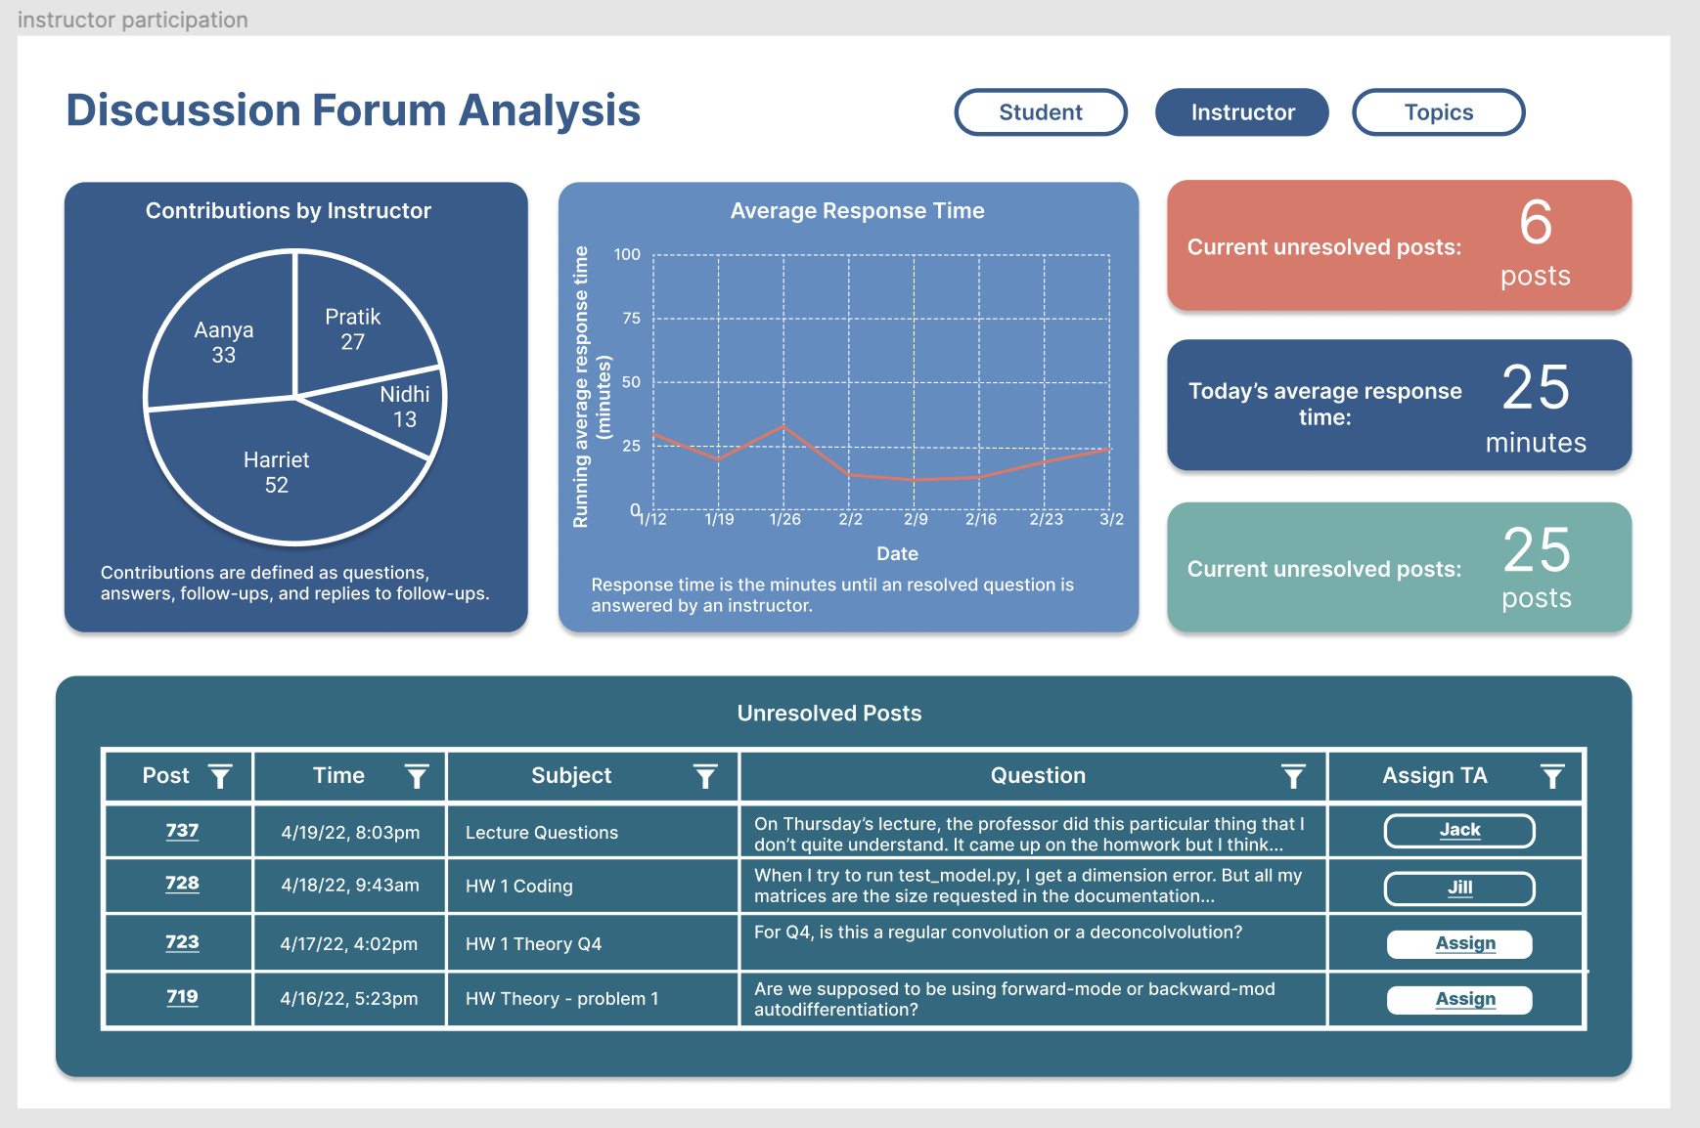
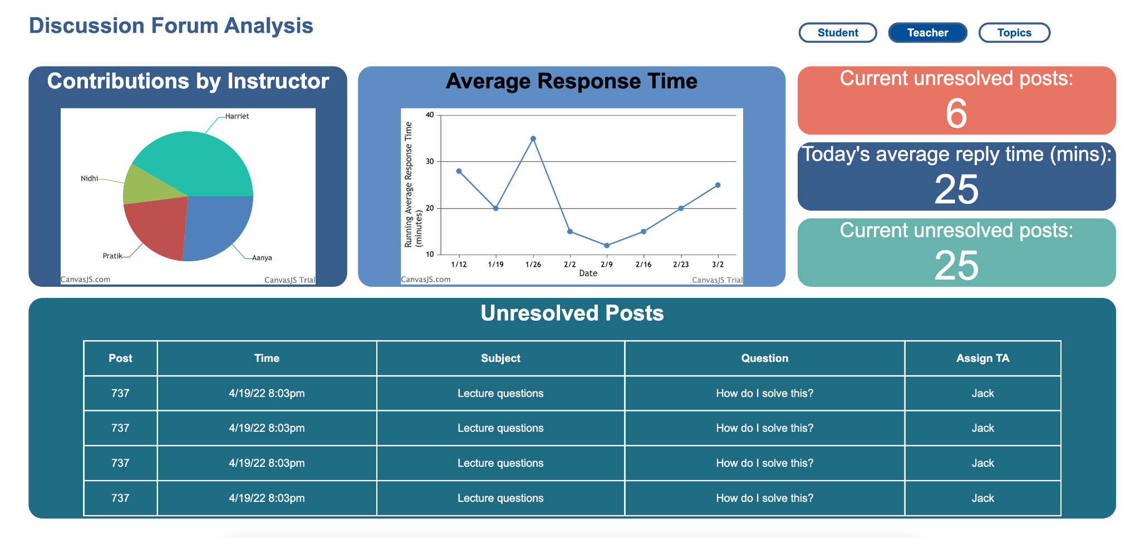
Outcomes - Web Application
Notes:
Gautam

Slide 20
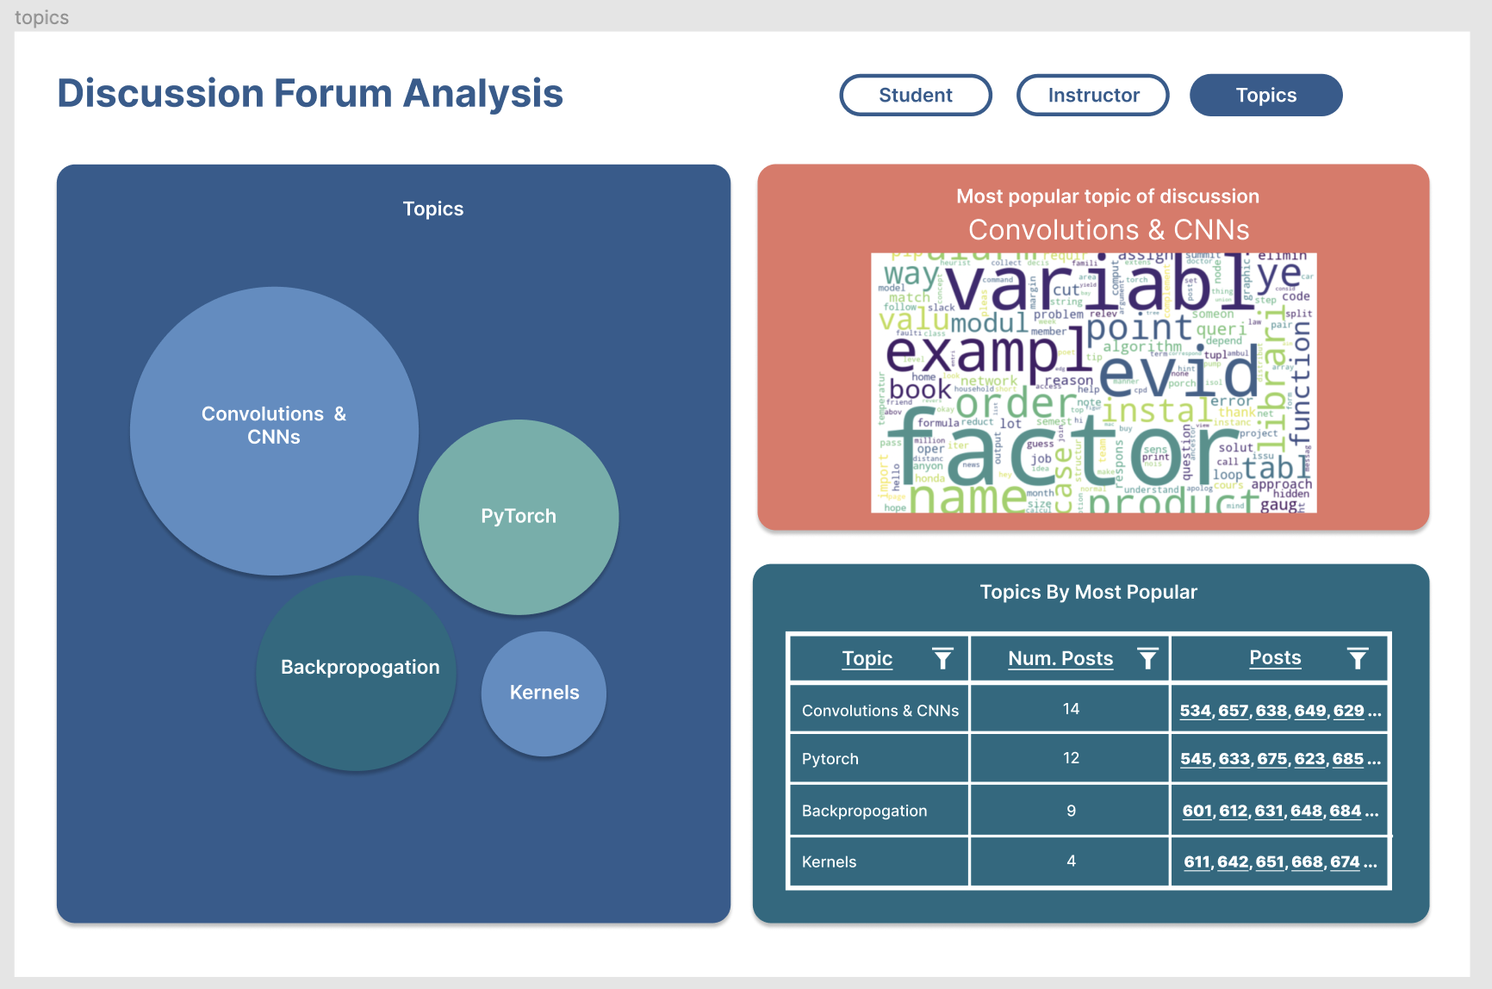
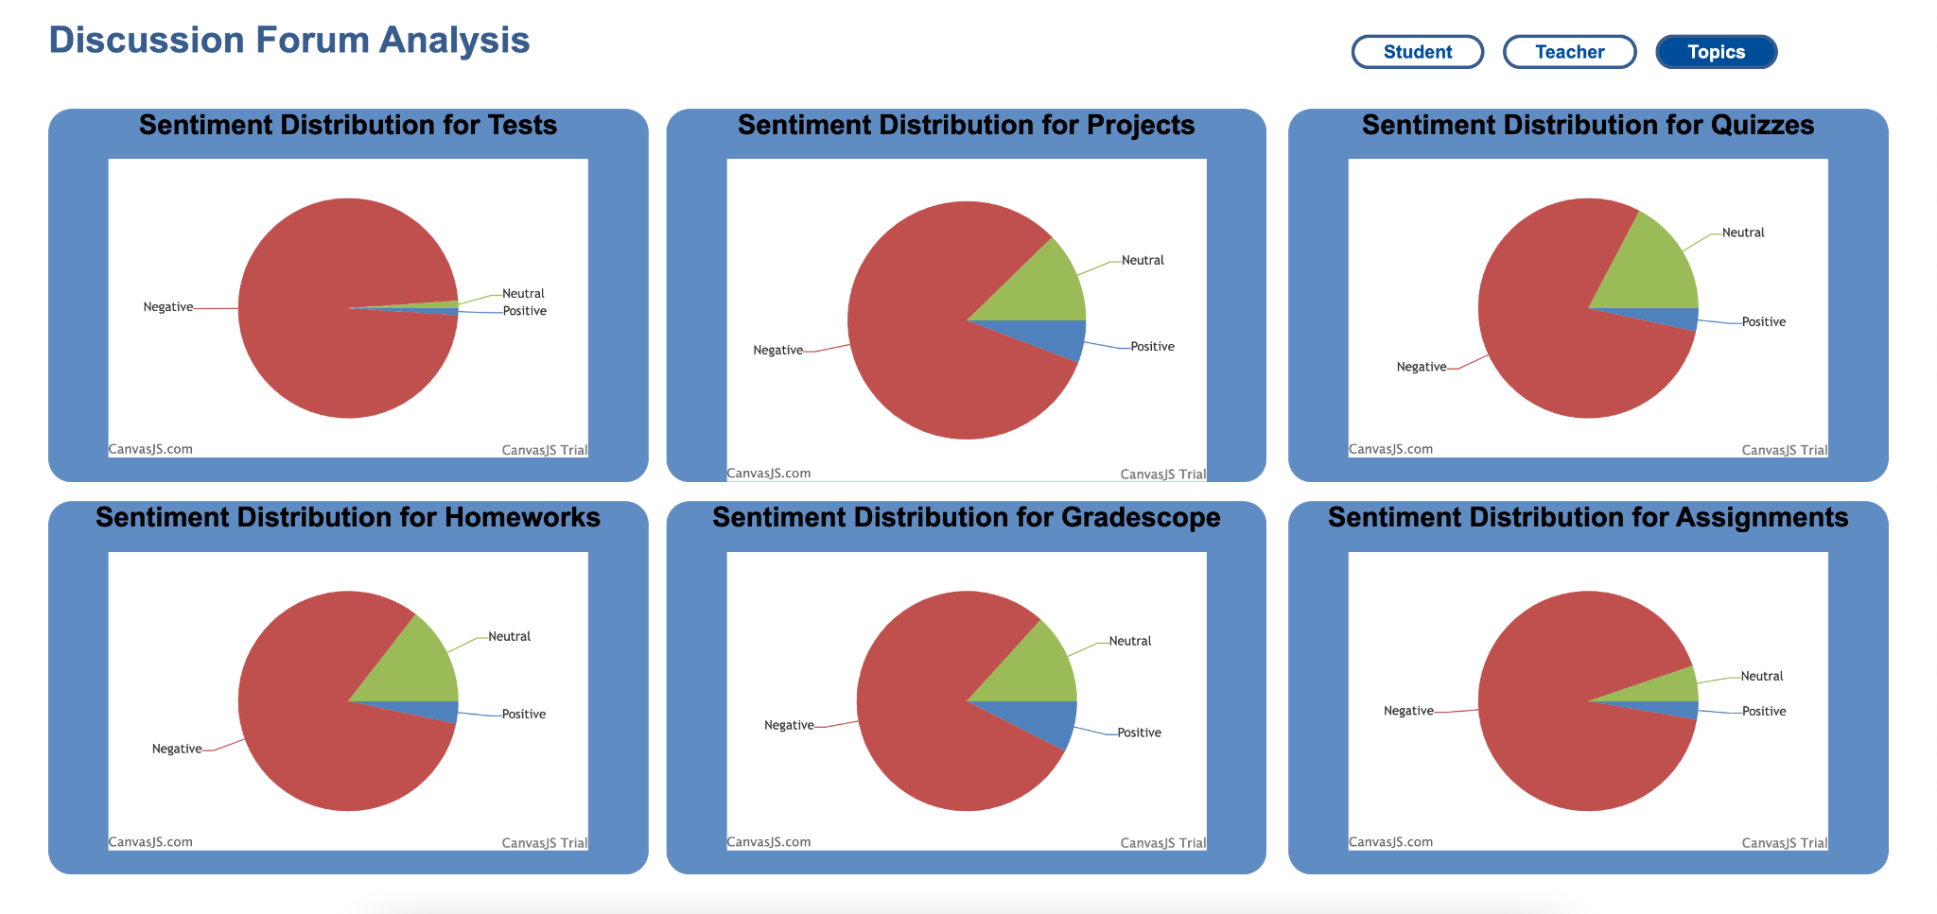
Outcomes - Web Application
Notes:
Gautam

Slide 21
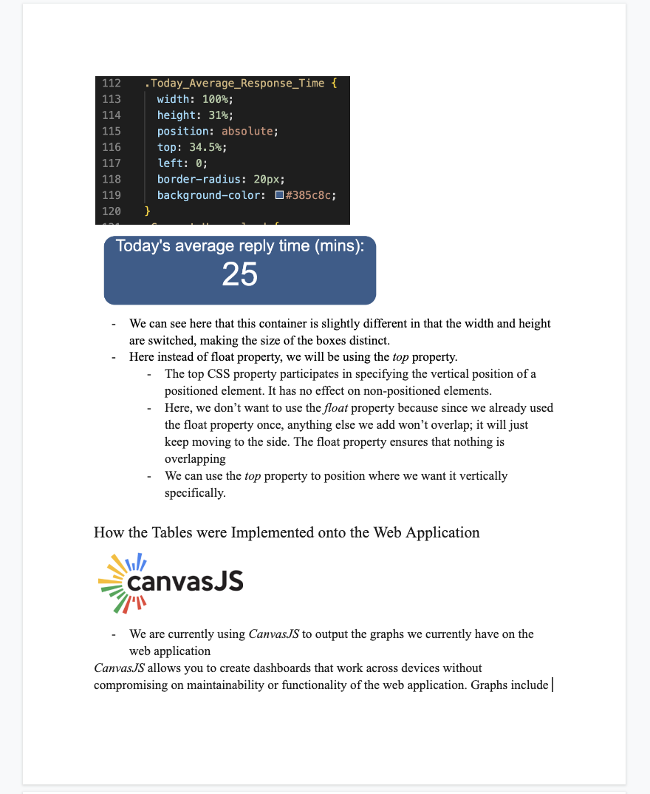
Outcomes - Documentation
Wrote a 9-paged Web Development Team Report for Fall 2022
Structure of Documentation
  Overall goal
  Explained all code that would be difficult from the first glance
  Gave more information about any outside frameworks and how to use them
  Challenges we faced
  Tasks for Spring 2023 we think should be their priority for their semester
Notes:
Ritika

Slide 22
Challenges and Learnings
What are the key challenges you faced? How did you overcome those?
→ Unable to reuse code from past semester due to lack of documentation. We started coding the webapp from scratch.
What did you learn in the process?
→ Learnt front-end technologies like React and Javascript, and create web app components like graphs, tables and charts using real-time data.
→ Learnt the importance of having helpful documentation when taking over a coding project.
Notes:
Ankit

Slide 23
Reflections and Future Steps
What we did well?
→ We sets weekly goals and made considerable progress every week of the semester.
→ All our teammates were very motivated and we learnt a completely new technology, React to build our interactive web application.
→ We built the webapp with all the required components.
Notes:
Ankit

Slide 24
Reflections and Future Steps
What could have been done differently/better?
→ We could have avoided making the Topic page twice with better communication between web-dev and data science team.
→ We could have spent more time researching beforehand as this would have helped us avoid doubling our work.
Steps and goals for next semester?
→ To connect web app to the backend database for all graphs and table.
→ To make the web app responsive that adapts to different screen sizes, orientations and devices.
→ Present the dashboards to professors and get feedback for further improvements.
Notes:
Ankit

Slide 25
Conclusion
Project Roadmap
  Connecting the web-app with data science backend, testing in Piazza sandbox environment and user feedback from instructor team
Model Development
  Integrating cognitive presence and aspect based sentiment analysis models to generate more granular insights for instructors
    Allow TAs to respond to an incoming question from the top matched responses from previous semester’s data using topic modeling
Documentation
  1 document each for Data Science and Web-Dev teams to take things forward from here
Notes:
Pratik
To conclude, the next steps in the roadmap is connecting the web-app front-end with data science models backend, and on the data science end, try integrating the cognitive presence model, aspect-based sentiment analysis and topic modeling to generate more granular insights for the instructors. We’ve created some documentation to help future teams pick up from here and take this project forward. Thank you for your time.

Slide 26
Citations
Garrison, D. R., Anderson, T., & Archer, W. (1999). Critical Inquiry in a Text-Based Environment: Computer Conferencing in Higher Education. The Internet and Higher Education, 2(2–3), 87–105. https://doi.org/10.1016/S1096-7516(00)00016-6
Garrison, D. R., Anderson, T., & Archer, W. (2001). Critical thinking, cognitive presence, and computer conferencing in distance education. American Journal of Distance Education, 15(1), 7–23. https://doi.org/10.1080/08923640109527071
Devlin, J., Chang, M. W., Lee, K., & Toutanova, K. (2018). Bert: Pre-training of deep bidirectional transformers for language understanding. arXiv preprint arXiv:1810.04805.
Medhat, Walaa, Hassan, Ahmed, Hoda, Korashy (2014). Sentiment analysis algorithms and applications: A survey. Ain Sham Engineering Journals. https://doi.org/10.1016/j.asej.2014.04.011
MacMillan, Kelsey, and James D. Wilson. Topic Supervised Non-Negative Matrix Factorization, Arxiv, 4 July 2017, https://arxiv.org/pdf/1706.05084.pdf.
Beri, Aditya. “Latent Dirichlet Allocation.” Latent Dirichlet Allocation, CodeChef-VIT, 27 Jan. 2021, https://medium.com/codechef-vit/latent-dirichlet-allocation-812bb8099518.
Rolczyński, Rafał. Do You Trust in Aspect-Based Sentiment Analysis? - SCALAC, https://scalac.io/wp-content/uploads/2021/04/Ebook_Explainable-Sentiment-Analysis.pdf.

Slide 27
Questions?

Slide 28

Community of Inquiry
“a group of individuals who collaboratively engage in purposeful critical discourse and reflection to construct personal meaning and confirm mutual understanding”
Elements of an Educational Experience (Garrison et al., 1999)

